Slide 1
Goods Movement: Is it all it’s cracked up to be?
Jon Haveman
Chief Economist, BAC Economic Institute
May, 2012

Slide 2
Outline
Trade magnitudes
Impacts of port activity
What if it doesn’t happen here?
Summary
World Logistics Center

Slide 3
Waterborne Goods Movement is Important in the State
Port of Los Angeles:
$273 B in 2011 (M exceeds X 5-1)
70 B lbs in 2011
6.2 M Loaded TEUs in 2011
Port of Long Beach
$95 B in 2011 (M exceeds X 2-1)
44 B lbs in 2011
4.5 M Loaded TEUs in 2011
Port of Oakland
$45 B in 2011 (M exceeds X 1.5-1)
16 B lbs in 2011
1.8 M Loaded TEUs in 2011
LA+LB = 40% of value of all US imports

Slide 4
How important is port activity?
Benefits | Costs
Employment | Pollution
Tax Revenue | Congestion
Profits | Infrastructure
Increased Competition | Land Use
 | Aesthetics
 | Security

Slide 5
Ports and Employment
Goods movement seen as wave of employment future
Conventional wisdom:
Port activity increases employment
Port activity creates good jobs
Merits of expanding employment in this way not well established
High wages?
Upward mobility?
How many?

Slide 6
Wages
MEAN wages for logistics: $47,000
MEDIAN wages for logistics: $32,000
Bottom quartile: $18,000
It is in this bottom quartile that most of the unskilled workers would be employed

Slide 7
Upward Mobility
No evidence that these jobs provide more upward mobility than other jobs
Better paying jobs in this sector increasingly require a college education (Sales)
Entry level job opportunities estimated to outnumber upper tier jobs
By 18 to 1 over the next 6 years

Slide 8
Questions Remain Regarding Employment Effects
Wages
Port related jobs do appear to pay well
Upward mobility
No evidence that these are better than other jobs
Tenure
More turnover than at comparable jobs
Quantity
Very little evidence
SoCal does not have big #s in logistics
LAEDC Claim of 450,000 jobs (5%)
Others claim 20% of SoCal jobs

Slide 9
Land Use
Ports:
Waterfront property
Warehousing/distribution centers:
Remarkably few jobs per sq ft (1/2,000sqft)
Truck traffic
Widening the 710 in LA from 6-14 lanes
Widening the 60?

Slide 10
Aesthetics
Ports tend to reduce the desirability of surrounding neighborhoods
Equipment storage: mountains of containers
Port footprint
Cranes at the end of the road where there was open water
Pier 400 – changed blue water view of San Pedro hills to blue crane view
Nothing about activities related to goods movement is beneficial for local communities from an aesthetics perspective
Does sort of depend on what you like…

Slide 11
Aesthetics - Study
For Harbor Community Benefit Foundation
Will better understand the effects of port activity on:
Real estate values
Alternative business development
Demographics
Focused on San Pedro/Wilmington, but similar work should be performed for the Inland Empire

Slide 12
Could be Questioned as A Regional Employment Strategy
Quantities are not very large
Large in IE because LA is exporting them
Quality, given worker characteristics, is questionable
Argument: have lots of unskilled workers in the region that need work
Counter-argument: if you create lots of jobs for unskilled workers, you will invite more into the region
Demand creates its own supply!
Jobs have a large footprint (2,000 sqft/job)

Slide 13
Tax Revenue and Profits
Tax Revenues: in excess of $2.5B from SoCal
State and local
Sales taxes, fuel taxes, property taxes
Profits
Freight handling, logistics, warehousing, etc.
Do these represent net increases in regional revenues and profits?

Slide 14
Port Activity Increases Competition
Cheap inputs to production
Cheaper goods on the shelves

Slide 15
Pollution
Port activity relies heavily on the use of diesel fuel
Ships – bunker fuel
On-port equipment
Trucks and trains
Results in significantly higher rates of cancer risk in local communities

Slide 16
LA’s Pollution Problem: The Ports are Major Contributors
Increased Cancer Risk per Million people from to Diesel Emissions

Slide 17
Progress is Being Made
In 2002, costs of pollution estimated at $7,000/job
Each of California’s 3 major ports have very substantive programs in place to deal with pollution
More must be done by the private sector to unload the communities of the pollution burden

Slide 18
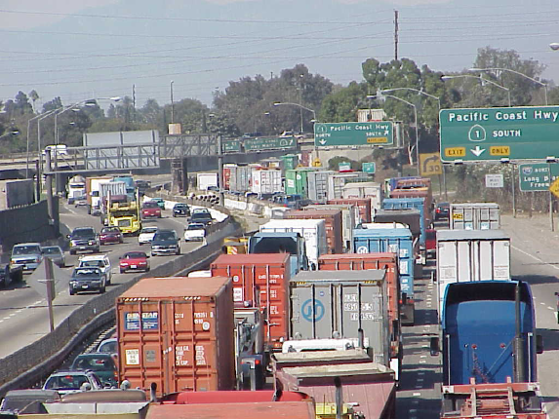
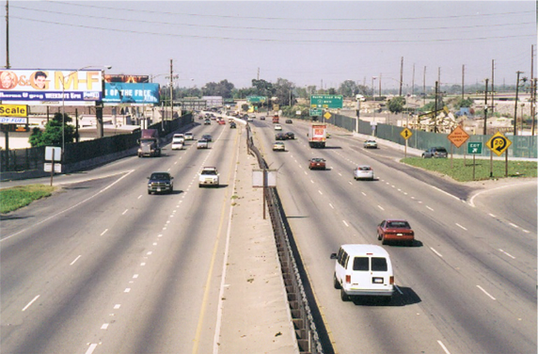
LA’s Congestion Problem: I-710 w/ and w/o Port Traffic
An Average Day A Day During the Port Closure: ‘03

Slide 19
Dealing with Congestion is Costly
Major identified improvements:
Widening the I-710 freeway
Alameda Corridor East
Identified costs for SoCal (old #s):
Total ($ Millions) | 11,962
Los Angeles Region | 8,190
San Diego Region | 3,709
Imperial County Region | 63

Slide 20
Port Security
Ports are both a conduit and a target
Concentrating too much port activity in one place establishes a vulnerability
Protecting the ports is nearly impossible, so many suggest that emphasis should be on response
Local communities bear the risk

Slide 21
What if it doesn’t happen here?
Judging from the rhetoric, you’d think that the sky would fall.
The answer is location specific:
Los Angeles – Not much
60-75% heads east…
Bay Area – Local hardship

Slide 22
Summary
California is at the forefront of waterborne goods movement for the United States
This provides local benefits, but do they exceed the local costs?
Much of the trade that flows through California could, in fact, go elsewhere
See: Panama Canal

Slide 23
Externalities Should be Compensated/Mitigated
Port of LA is starting to get it
Though their approach is curious
Swimming pool instead of aesthetics study?
Mitigation or Compensation is economically efficient
Not difficult, just expensive
BUT: Compensating for externalities is will raise the price of imported goods
NO
Will raise the price paid at the counter
Will LOWER the price paid overall
Will create jobs

Slide 24
World Logistics Center
41.6 million sq ft
Warehouse/distribution
Estimates suggest:
20,000 permanent jobs
$4.2 billion in economic benefits
$2.6 billion in payroll

Slide 25
Economic Critique
Modeling strategy is questionable
Uses average characteristics to model specific piece of an industry
Are 20,000 jobs really permanent?
Why not evaluate past experience?
Ontario? Other locations w/lots of new warehousing
Warehousing came online so quickly that an “event” study is very doable

Slide 26
Economic Critique (2)
Will jobs accrue to Moreno Valley residents or will workers commute in?
High wage, e.g., sales jobs may be elsewhere
Incomes estimated are based on averages for sector
not median
Not targeted at warehouse workers
Not clear that data capture actual wages of workers
Use of temp workers is high
Not classified as logistics workers
No accounting for externalities!!!

Slide 27
What investment is needed to support the project?
Hasan Ikrata:
“It will require the infrastructure, and anyone who thinks differently will have to check their math.”
What could be done with the resources necessary to facilitate the success of this project?
What if those resources were devoted to generating a more desirable business climate?
What if devoted to educating/training workforce?

Slide 28
Local warehouse issue?
Zoning – for residential?
Bedroom community
Why grasp at straws to improve the jobs/housing balance?
How does the city want to define itself
This development can define the city for:
Decades? Forever?
Discourages other development
Economic development is complicated
Simple obvious solutions are not always the right way to go

Slide 29
Miscellaneous Pros and Cons
Will it provide the economic base upon which to build?
Will it build a permanent low-skilled labor force into the community?
Distinct lack of upward mobility.
Will the negative externalities be worth the economic benefits?
Not nearly enough evidence presented to make an informed decision.
Sufficiently big deal to warrant a full accounting of the impact.

Slide 30
Bay Area Council Economic Institute
Regional Analysis
Business & Market Analysis
Ports & Infrastructure Analysis
Economic Impact Analysis
Public Policy Analysis
Jhaveman@BayAreaCouncil.org
415-336-5705

