Slide 1
East Bay / San Francisco Economic Forecast: 2011-2013
Jon Haveman
Chief Economist, BAC Economic Institute
December, 2011

Slide 2
Unemployment
 | Oct- 2009 | Oct- 2010 | Oct- 2011
California | 12.1 | 12.5 | 11.7
Bay Region
Oakland (MD) | 11.3 | 11.2 | 10.1
San Francisco (MD) | 10.4 | 10.3 | 9.2
San Jose (MSA) | 11.7 | 11.0 | 9.7
Southern Calif.
Los Angeles | 12.1 | 12.9 | 12.2
San Diego | 10.5 | 10.5 | 9.7
Orange County | 9.7 | 9.4 | 8.5
Source: California Employment Development Department

Slide 3
Labor Markets
 | Oct- 2011 (‘000s) | Peak to Current (%)
Inland Empire | 1,124 | -12.0
Orange County (MD) | 1,378 | -9.7
Oakland (MD) | 947 | -9.9
Los Angeles | 5,173 | -8.4
CALIFORNIA | 14,151 | -7.0
San Diego | 1,248 | -5.1
San Francisco (MD) | 953 | -4.9
San Jose | 882 | -4.2
Source: California Employment Development Department

Slide 4
What do we know about EB/SF Economies?
East Bay
Manuf. is alive and well
Housing - big story
Has a big seaport
Research Labs
San Francisco
Finance oriented
Has a big airport
Social media
Biotech
Aging
Business services are important
Highly educated/high income
Venture capital plays a big role
Intimately linked with rest of Bay Area

Slide 5
Education across counties

Slide 6
Income
Source: Bureau of Economic Analysis

Slide 7
Age Related Challenges
Source: California Department of Finance

Slide 8
Age Related Challenges
Source: California Department of Finance

Slide 9
Employment by Industry
Source: California Employment
Development Department

Slide 10
Employment by Industry
Source: California Employment
Development Department

Slide 11
Bay Area Employment Interlinkages

Slide 12
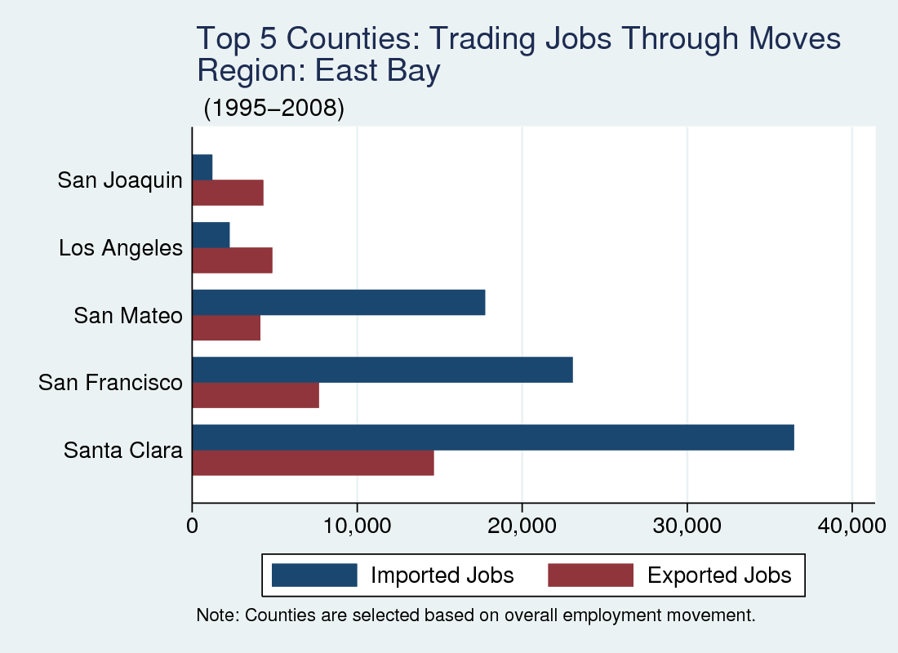
Job Moves: East Bay

Slide 13
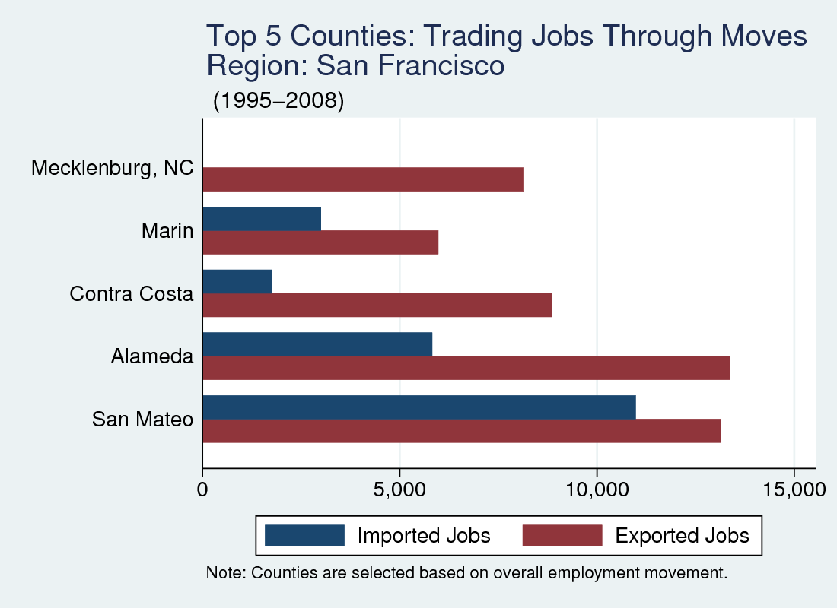
Job Moves: SF City

Slide 14
Emplt Dynamics in Bay Area
Source: NETS 2009, Calculations by BACEI

Slide 15
Manufacturing
Source: California EDD, Bureau of Labor Statistics

Slide 16
Manufacturing trends

Slide 17
Progress on Jobs: East Bay

Slide 18
Employment by Industry
Source: California Employment
Development Department

Slide 19
Progress on Jobs: San Francisco MD

Slide 20
Employment by Industry
Source: California Employment
Development Department

Slide 21
Port of Oakland

Slide 22
Oakland Intl. Airport
Source: RITA

Slide 23
San Francisco Intl. Airport
Source: RITA

Slide 24
Venture Capital
Q3-2011 | Value of All Deals (Millions) | % of Total US VC
California | 3,287 | 47
Bay Area | 2,668 | 38
Oakland (MD) | 196 | 3
San Francisco (MD) | 1,554 | 22
San Jose (MSA) | 897 | 13
United States | 6,952
Source: PriceWaterhouseCoopers MoneyTree

Slide 25
Venture Capital Top 10 VC Investments of 2010 in SF (MSA)
Company | City | Amount ($ Millions) | Industry
Twitter Inc. | San Francisco | 200 | Media and Entertainment
BrightSource Energy Inc. | Oakland | 150 | Industrial Energy
Pacific Biosciences of California Inc. | Menlo Park | 109 | Biotechnology
Trilliant Inc. | Redwood City | 106 | Software
Castlight Health Inc. | San Francisco | 60 | Software
Solazyme Inc. | South San Francisco | 60 | Biotechnology
BridgeLux Inc. | Livermore | 59 | Semiconductors
SunRun Inc. | San Francisco | 55 | Industrial Energy
NGM Biopharmaceuticals Inc. | South San Francisco | 51 | Biotechnology
Amyris Biotechnologies Inc. | Emeryville | 47 | Biotechnology
Source: PriceWaterhouseCoopers MoneyTree
Notes:
Make a chart just like this one, but for the SF MD and the San Jose MSA

Slide 26
Venture Capital Top VC Investment by Sector in 2010
 | Bay Area | East Bay | San Francisco | San Jose
1 | Software | Industrial Energy | Software | Industrial Energy
2 | Industrial Energy | Medical Devices and Equipment | Biotechnology | Software
3 | Biotechnology | Biotechnology | Media and Entertainment | Semiconductors
4 | Medical Devices and Equipment | Semiconductors | IT Services | Medical Devices and Equipment
Source: PriceWaterhouseCoopers MoneyTree

Slide 27
Local Housing Markets
 | Sales Volume |  |  | Median Price
 | Oct-10 | Oct-11 | % Chng | Oct-10 | Oct-11 | % Chng
Santa Clara | 1,374 | 1,417 | 3.10% | $502,500 | $450,000 | -10.40%
Contra Costa | 1,333 | 1,329 | -0.30% | $260,000 | $250,750 | -3.60%
Marin | 205 | 230 | 12.20% | $630,000 | $602,909 | -4.30%
Riverside | 3,264 | 3,026 | -7.30% | $198,000 | $187,000 | -5.60%
San Bernardino | 2,343 | 2,300 | -1.80% | $150,000 | $150,000 | 0.00%
Sonoma | 386 | 490 | 26.90% | $309,000 | $283,500 | -8.30%
Orange | 2,298 | 2,241 | -2.50% | $438,000 | $405,000 | -7.50%
Alameda | 1,252 | 1,308 | 4.50% | $365,000 | $340,000 | -6.80%
Los Angeles | 5,470 | 5,830 | 6.60% | $325,000 | $300,000 | -7.70%
Solano | 517 | 554 | 7.20% | $205,500 | $188,000 | -8.50%
San Diego | 2,750 | 2,759 | 0.30% | $334,500 | $315,000 | -5.80%
San Mateo | 528 | 566 | 7.20% | $561,250 | $525,000 | -6.50%
Ventura | 619 | 673 | 8.70% | $355,000 | $335,000 | -5.60%
San Francisco | 436 | 448 | 2.80% | $652,000 | $635,000 | -2.60%
Napa | 91 | 102 | 12.10% | $307,000 | $310,000 | 1.00%
Source: DataQuick

Slide 28
Median Home Prices Through Q3-2011
Price Declines – Peak to Current
Bay Area: -39%
Alameda: -36%
Contra Costa: -47%
Santa Clara -27%
Source: DataQuick

Slide 29
Median Home Prices Through Q3-2011
Price Declines – Peak to Current
Bay Area: -39%
Marin: -18%
San Francisco: -19%
San Mateo: -21%
Source: DataQuick

Slide 30
How Many Underwater? as of Q3-11
State | # Mortgages Underwater | Negative Equity Share
Nevada | 328,369 | 58.3
Arizona | 617,876 | 47.1
Florida | 1,911,419 | 43.9
Michigan | 477,104 | 34.5
California | 2,030,292 | 29.7
Georgia | 488,310 | 30.0
United States Total | 10,723,410 | 22.1
Local MSAs
Oakland-Fremont-Hayward | 157,146 | 29.0
San Jose-Sunnyvale-Santa Clara | 60,382 | 17.5
San Francisco-San Mateo-Redwood City | 33,036 | 10.2
Source: First American CoreLogic

Slide 31
Home Price Forecast
San Francisco
East Bay
San Jose
Source: Beacon Economics

Slide 32
Foreclosures Through Q3-2011
Current Rates
Bay Area: 2.6
Alameda: 2.6
Contra Costa: 4.2
San Francisco: 0.7
San Mateo: 1.3
Marin: 1.2
Santa Clara: 1.4
Foreclosures / 1,000 Homes
Source: DataQuick

Slide 33
Total NonFarm Employment
Source: UCLA Anderson

Slide 34
Industry Forecast
Source: UCLA Anderson

Slide 35
Industry Forecast
Source: UCLA Anderson

Slide 36
Professional and Business Services
Source: UCLA Anderson

Slide 37
Leisure and Hospitality
Source: UCLA Anderson

Slide 38
Construction
Source: UCLA Anderson

Slide 39
Summary

Slide 40
Bay Area Council Economic Institute
Regional Analysis
Business & Market Analysis
Ports & Infrastructure Analysis
Economic Impact Analysis
Public Policy Analysis
Jhaveman@BayAreaCouncil.org
415-336-5705

